Slide 1
PMO Reporting Analysis
IT Portfolio Projects: Comprehensive Reports and Data-Driven Dashboards

Slide 2
Project Objective
"The project aimed to develop a comprehensive IT Portfolio report and a data-driven dashboard in Power BI. The objective was to provide actionable insights into key performance metrics and trends, enabling portfolio and project managers to effectively monitor and manage their projects."

Slide 3
Imported data to Power BI
Analysed and cleaned the spreadsheet data in Excel, identifying any missing or incorrect values.
Imported the refined data into Power BI.
Developed DAX formulas in Power BI to structure the data accurately.
Set up the data for clear and impactful visualizations in Power BI.

Slide 4
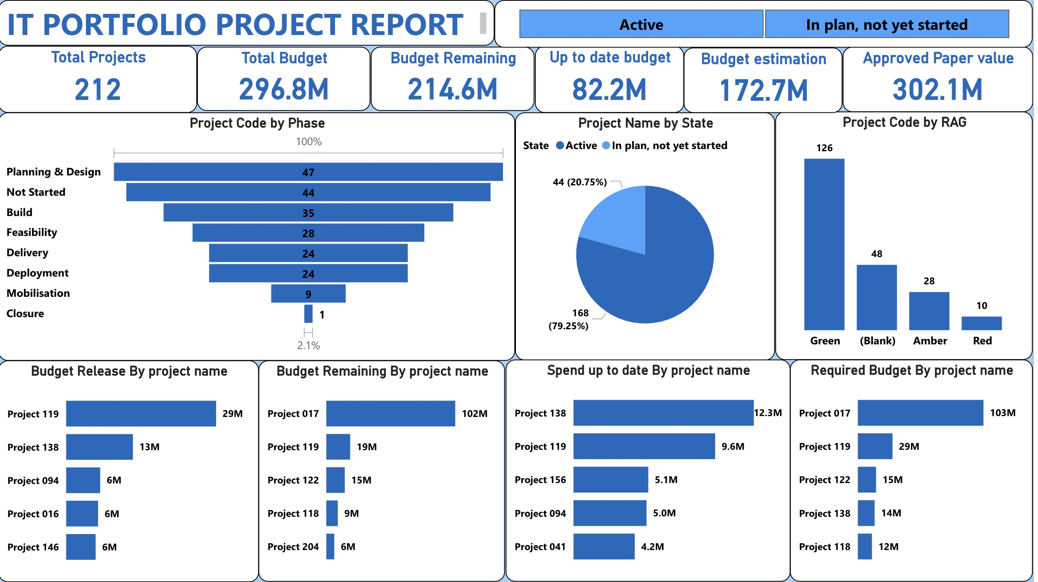

Slide 5
Insights
There are 212 projects in total.
The total budget allocated for these projects is 296.8M.
Most projects are in the Planning & Design (47 projects) and Not Started (44 projects) phases.
Fewer projects are in the Mobilization (9 projects) and Closure (1 project) phases.
Active Projects: 79.25% (168 projects)
In Plan, Not Yet Started: 20.75% (44 projects)
Green: 126 projects
Amber: 28 projects
Red: 10 projects
Blank: 48 projects (These may represent projects not yet assessed for risk or missing data)

Slide 6
Insights
Project 119 has the highest budget release at 29M.
Project 017 has the highest remaining budget at 102M.
Project 017 also requires the highest additional budget at 103M.
Project 138 has the highest spend up to date at 12.3M.
Project 119 follows with a spend of 9.6M.
Key Observation :
A significant portion of the budget is remaining (over 214.6M), indicating a large amount of work yet to be done.
A small number of projects (10) are flagged as Red (high risk), and 28 projects are Amber (moderate risk).
A substantial amount of the approved paper value (302.1M) may be tied to future phases or not fully utilized yet.

Slide 7
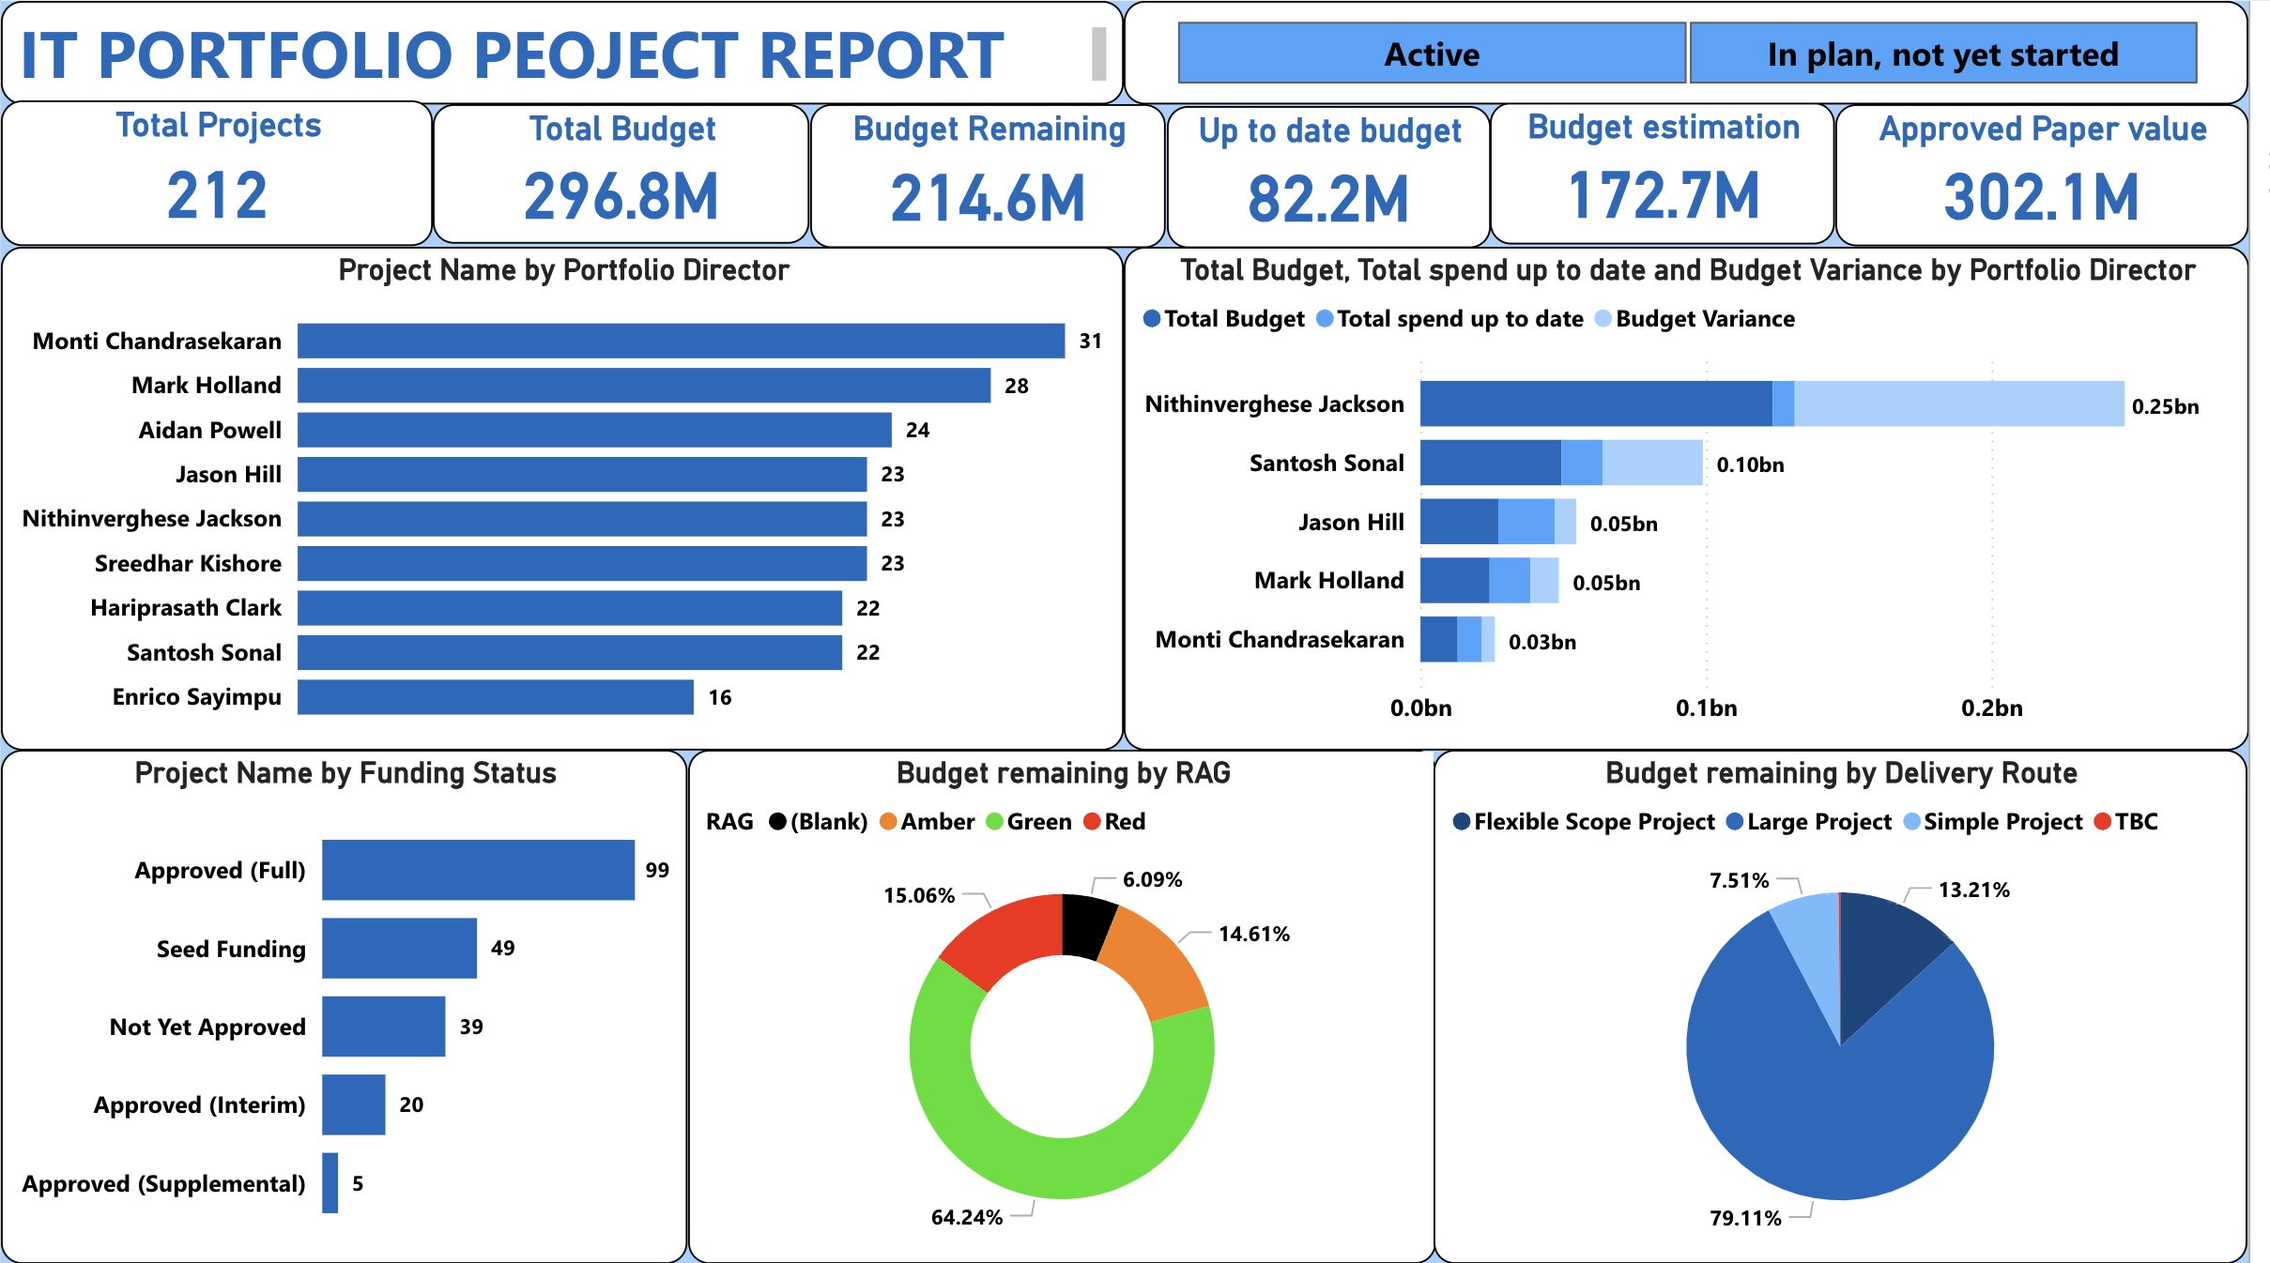

Slide 8
Insights
Monti Chandrasekaran oversees the most projects (31).
Mark Holland follows with 28 projects.
Nithinverghese Jackson manages the largest budget (~$250 million) with significant spending up to date.
Monti Chandrasekaran, despite managing the most projects, has a smaller budget with a minimal amount spent so far.
Approved (Full): 99 projects have full approval.
Seed Funding: 49 projects are in the seed funding stage.
Green: 64.24% of the budget remaining is allocated to projects marked Green, indicating they are on track.
Amber: 14.61% of the remaining budget is for projects with potential issues.
Red: 15.06% of the budget is tied to high-risk projects.
Blank: 6.09% is unclassified.

Slide 9
Insights
Flexible Scope Projects: These make up the majority, with 79.11% of the budget.
Large Projects: Account for 13.21% of the remaining budget.
Simple Projects: Constitute 7.51% of the budget.
Key Observation :
Monti Chandrasekaran and Mark Holland oversee a significant portion of the projects, but the budget distribution varies significantly across directors.
A majority of the budget is allocated to projects with a "Green" status, which is positive for portfolio health.
A large portion of the budget remains unspent, indicating either efficient budgeting or potential delays in project execution.

Slide 10
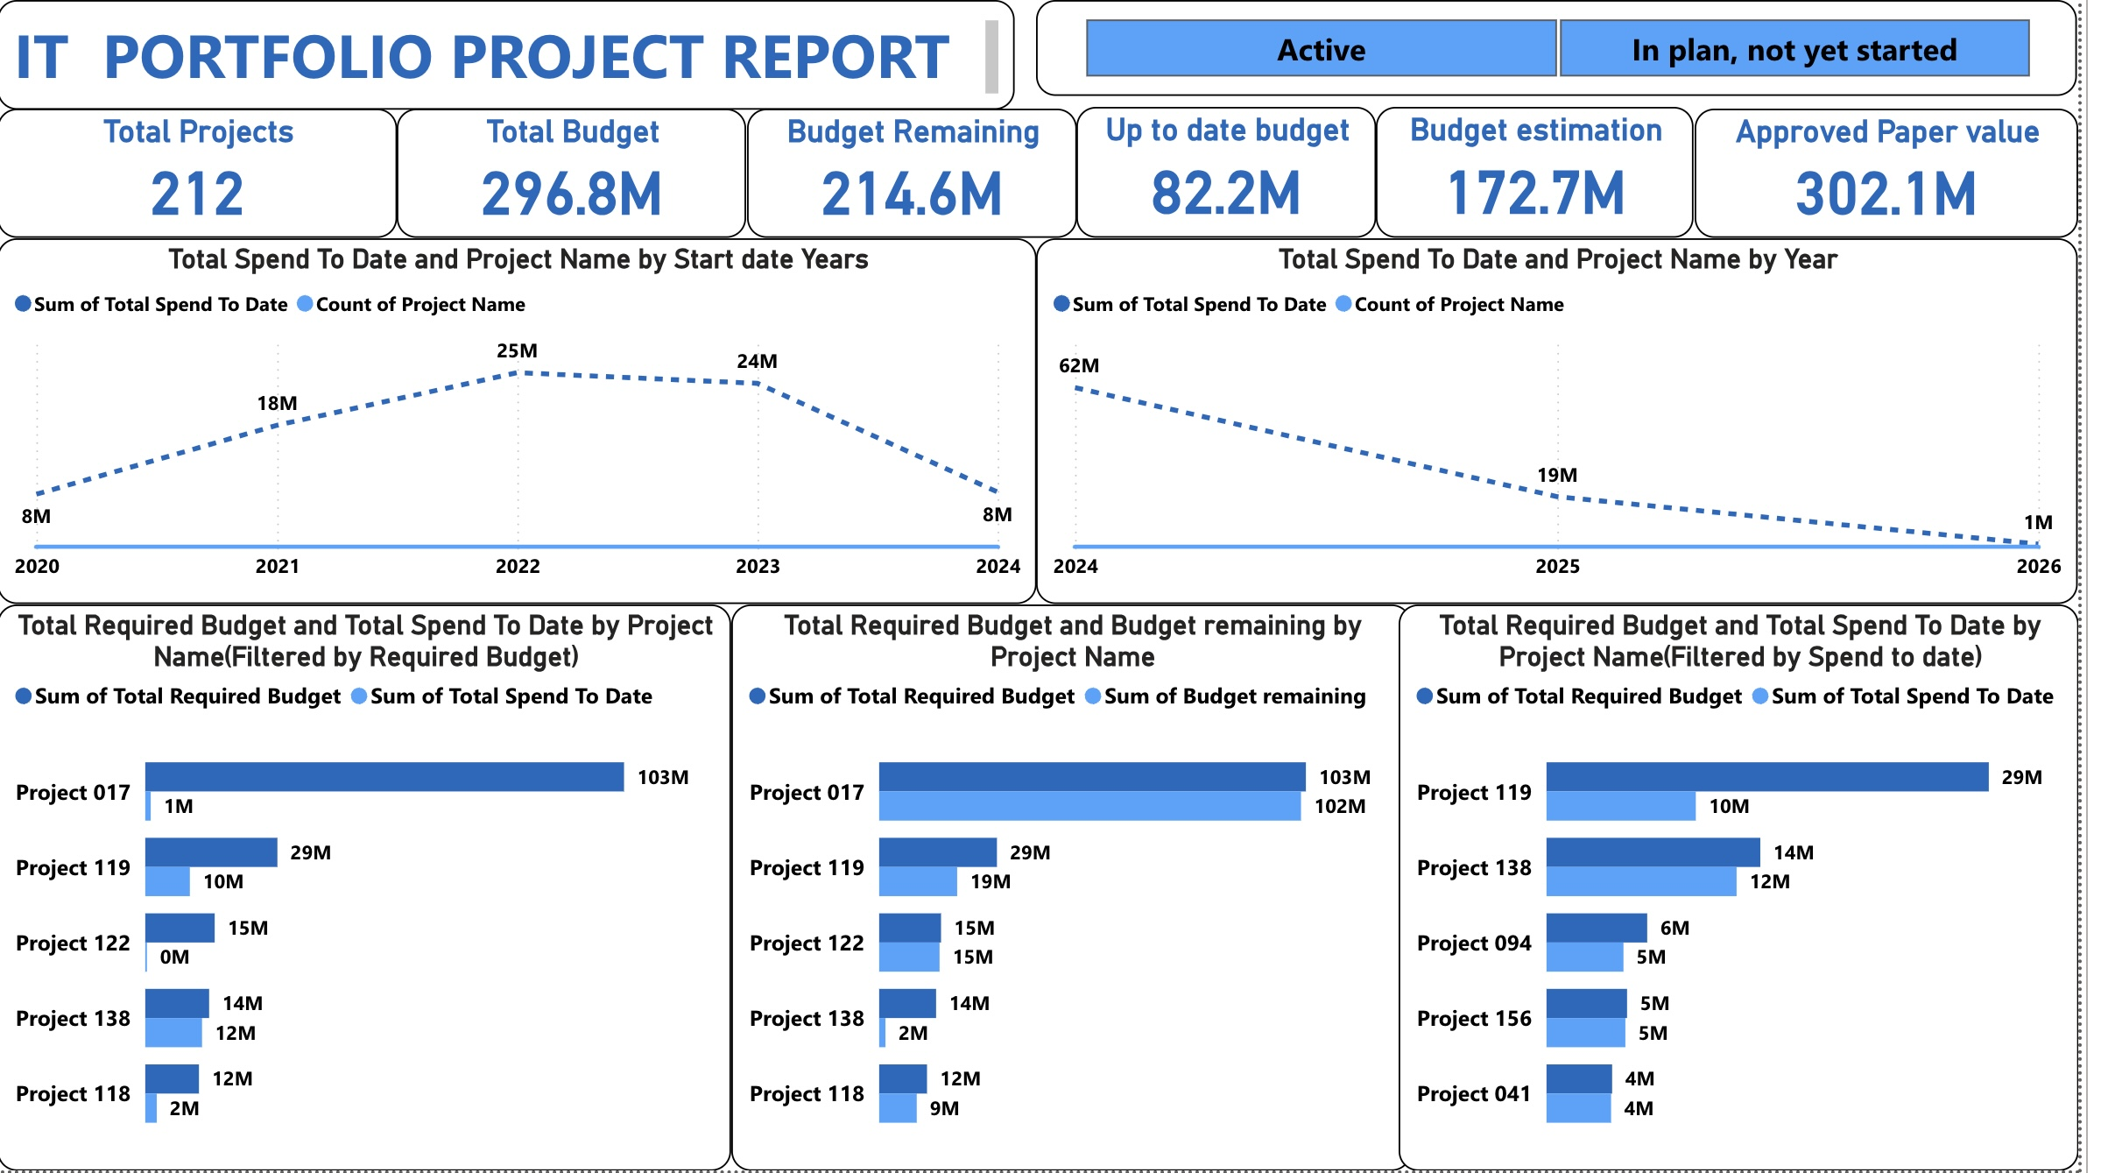

Slide 11
Insights
2020 to 2024: There is an increase in the total spend from 2020 (8M) to 2022 (25M), followed by a decline in 2023 (24M) and a significant drop projected for 2024 (8M).
2024 to 2026: The spend drops sharply in 2024 (62M) and continues to decline through 2025 (19M) and 2026 (1M).
Project 017: This project has the highest required budget of 103M but has only spent 1M so far. It also has nearly all its budget remaining (102M).
Project 119: Requires 29M, with 19M remaining, and has spent 10M so far.
Project 122 and 138: These projects have significant required budgets (15M and 14M respectively) but have either spent none or a small portion (15M and 2M remaining).
Project 119 and 138: Both have relatively lower required budgets (10M to 29M) but have already spent a significant amount compared to the budget.
Project 094, 156, and 041: These projects have smaller budgets (4M to 6M) but have spent almost all of their budgets.

Slide 12
Insights
Project 017 stands out as having a very high allocated budget with minimal spend, indicating a potential delay or inefficiency in utilization.
Projects like 119 and 138 are progressing in terms of budget utilization but still have significant funds remaining.
Smaller projects like 094, 156, and 041 have been efficient in utilizing their allocated budgets almost entirely.

Slide 13
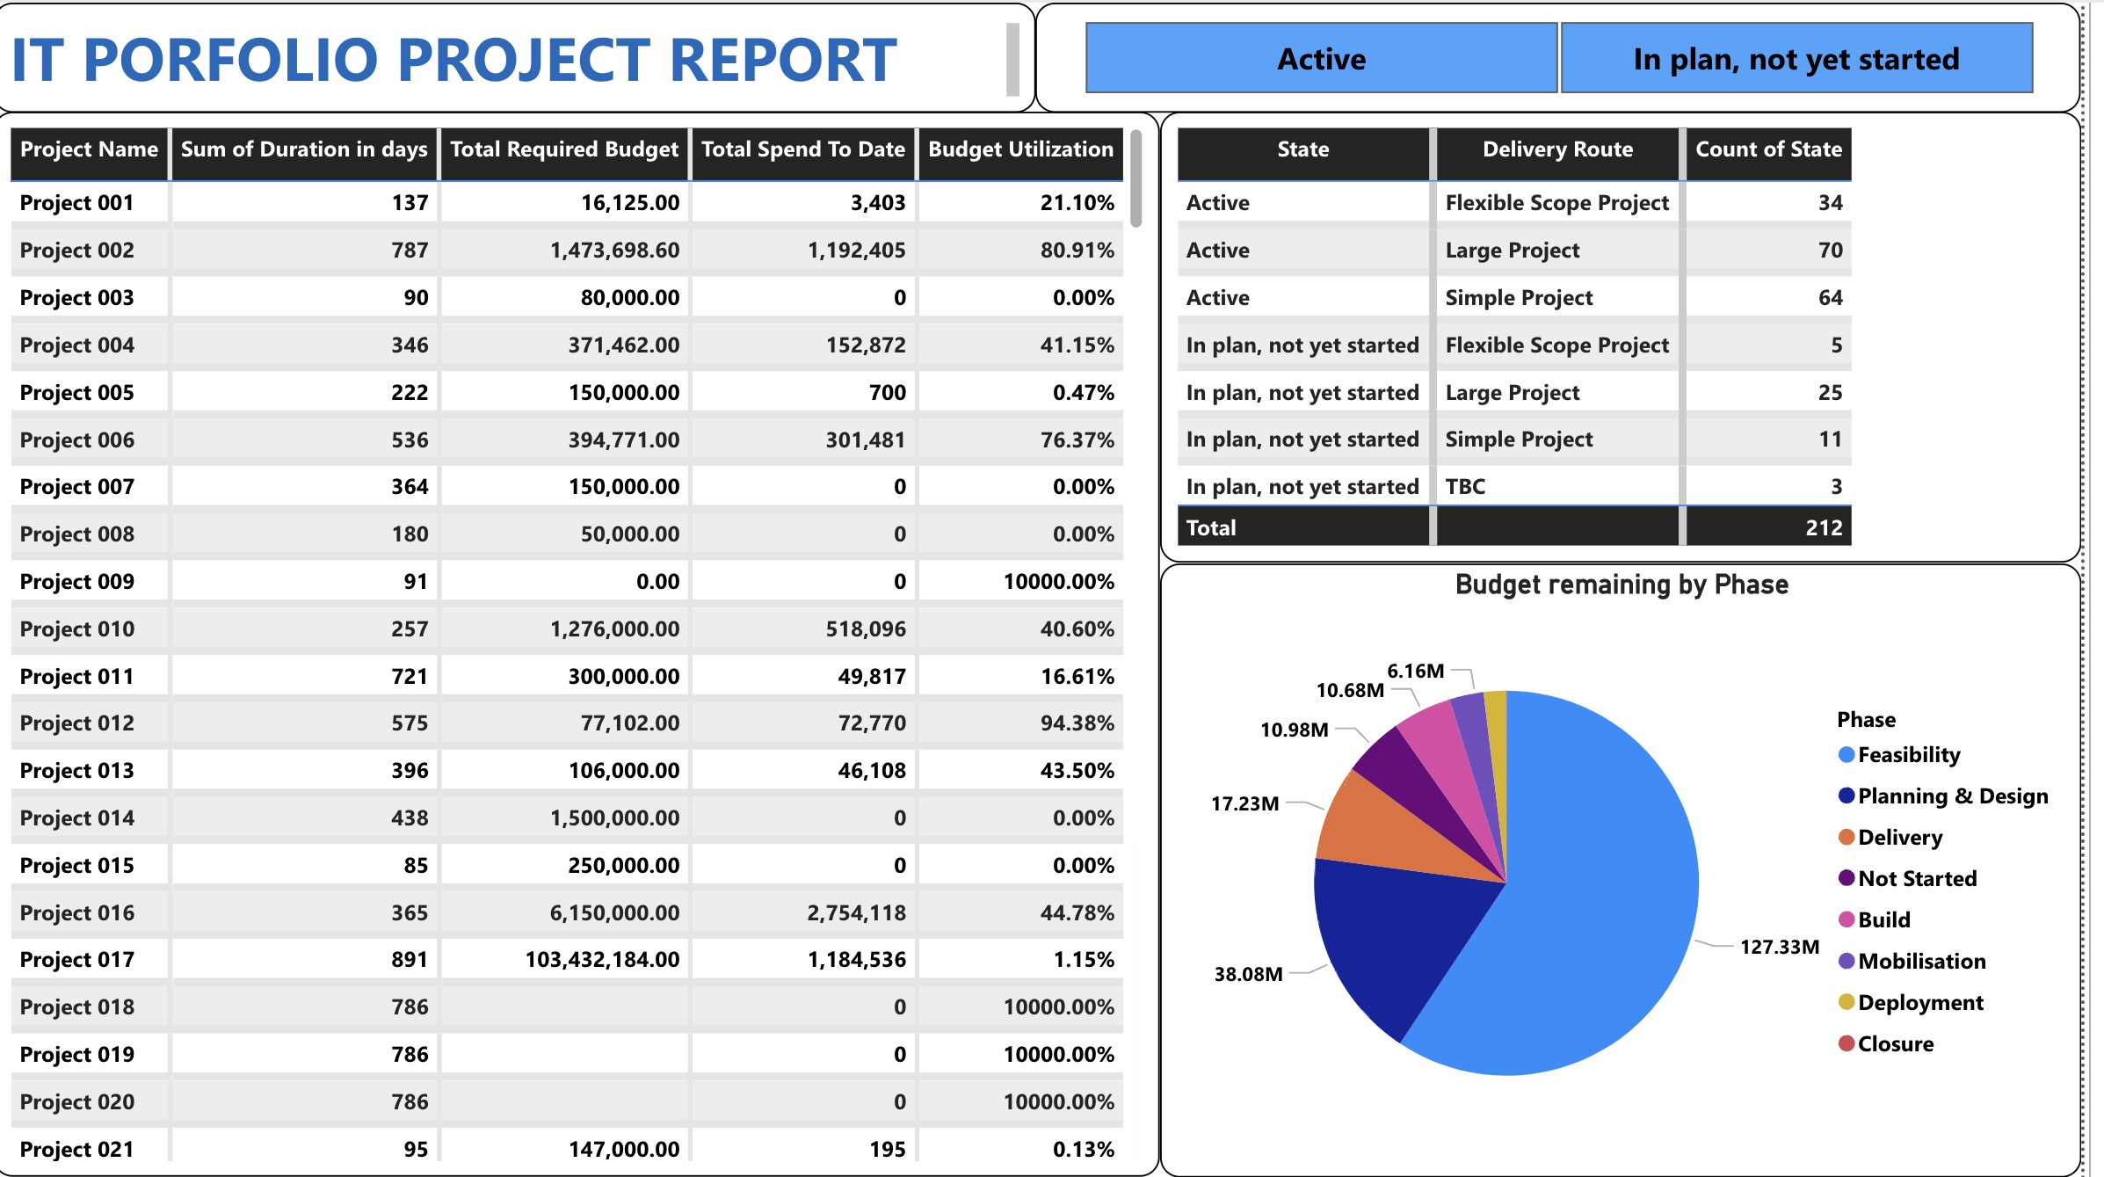

Slide 14
Insights
Project 017 has the highest required budget at £103,432,184 but has only spent £1,184,536, which is about 1.15% of the budget.
Project 002 has a high budget utilization of 80.91%, having spent £1,192,405 out of a £1,473,698.60 budget.
Project 012 has the highest budget utilization at 94.38%, with a very small remaining budget.
Feasibility phase has the largest remaining budget, approximately $127.33M.
Other phases like Planning & Design, Delivery, Build, Mobilisation, Deployment, and Closure have significantly smaller portions of the remaining budget.
The phase with the smallest remaining budget appears to be Deployment.
Flexible Scope Project: 34 active.
Large Project: 70 active.
Simple Project: 64 active.

Slide 15
Recommendations
Keep a close eye on projects with large budgets left, like Project 017, and speed up their progress.
Find ways to move projects from the "Not Started" phase into action to prevent unused budgets.
Create and apply strategies to reduce risks in the 38 projects marked as Amber and Red.
Make sure directors with many projects have enough support to manage them well.

Slide 16
conclusion
"In summary, the dashboards and insights I developed enabled the organization to make informed decisions on resource allocation and risk management, ultimately improving the efficiency and health of the entire IT portfolio."

Slide 17
THANK YOU

